Slide 1
UNDERGRAD SPACE PROJECT.
BY GROUP 5

Slide 2
GROUP MEMBERS
1. JAYMILLS, PRINCE - 10890540
2. ABOAGYE, FAFA - 10922580
3. NII GYAN, CHRISTIAN - 10880660
4. ANTWI-BOASIAKO, MAAME YAA HENEWAA - 10889628
5. NKRUMAH, AKUA SERWAA - 10912305

Slide 3
CONTENTS
ABOUT
MODEL USED
SOFTWARE DEVELOPMENT PROJECT CYCLE
UML USE CASE DIAGRAMS
SEQUENCE DIAGRAMS
REQUIREMENTS(FUNCTIONAL & NON-FUNCTIONAL)
TOOLS AND RESOURCES
PROJECT COST
ROLES OF MEMBERS
OTHERS

Slide 4
ABOUT The purpose of this project is to create a software that allows undergraduate students to access student report online. The site allows access to only students and administrators(lecturers). Where the lecturer is able to publish, upload and edit student report(pdfs) and students are able to view.

Slide 5
FEATURES OF THE WEBSITE.
User registration and login authentication system.
User’s App
Dashboard
Where administrators can upload pdf files.
Where users/students can view pdf files.

Slide 6
MODEL USED.
The model used for this project was the INCREMENTAL MODEL. Incremental Model is a process of software development where requirements divided into multiple standalone modules of the software development cycle. In this model, each module goes through the requirements, design, implementation and testing phases. Every subsequent release of the module adds function to the previous release. The process continues until the complete system achieved.

Slide 7
MODEL USED CONT’
We figured incremental model will be best because, the project had a lengthy development schedule ,meaning, the process of analyzing activity sequences, durations and resource requirements was a bit lengthy. Again, as students, we admitted to the fact that, we are not well skilled and trained therefore, the incremental model will be best. Lastly, the customer/client needed a quick release of the product, thus we had less time and had to result to using the incremental model.

Slide 8
MODEL USED CONT’
Because we used Incremental model, our errors were easily identified, our software was easier to test and debug. Also, it was flexible and easier to manage risk because, the risk was handled during its iteration.
The only problem we faced while using this model was the need for good planning and well defined interfaces.

Slide 9
The various phases of incremental model we used are as follows:
1. Requirement analysis: In the first phase of the incremental model, the product analysis expertise identifies the requirements. And the system functional requirements are understood by the requirement analysis team. To develop the software under the incremental model, this phase performs a crucial role.

Slide 10
SOFTWARE DEVELOPMENT CYCLE CONT’
2. Design & Development: In this phase of the Incremental model of SDLC, the design of the system functionality and the development method are finished with success. When software develops new practicality, the incremental model uses style and development phase.

Slide 11
SOFTWARE DEVELOPMENT CYCLE CONT’
3. Testing: In the incremental model, the testing phase checks the performance of each existing function as well as additional functionality. In the testing phase, the various methods are used to test the behavior of each task.

Slide 12
SOFTWARE DEVELOPMENT CYCLE CONT’
4. Implementation: Implementation phase enables the coding phase of the development system. It involves the final coding that design in the designing and development phase and tests the functionality in the testing phase. After completion of this phase, the number of the product working is enhanced and upgraded up to the final system product

Slide 13
REQUIREMENT
IMPLEMENTATION
MAINTENANCE
RETIREMENT
DESIGN
TESTING

Slide 14
TOOLS:
Visual studio code.
Microsoft Visio.
PgAdmin.

Slide 15
RESOURCES
HTML
CSS
BOOTSTRAP
DJANGO
SQL

Slide 16
FUNCTIONAL AND NONFUNCTIONAL REQUIREMENTS
FUNCTIONAL REQUIREMENTS | NON-FUNCTIONAL REQUIREMENTS
USER REGISTERATION | SECURITY
LOGIN AUTHENTICATION | RECOVERABILITY
FUNTIONALITY TO ADD PROJECT BY ADMIN | SCALABILITY
FUNCTIONALITY TO VIEW PROJECT BY USERS | USABILITY

Slide 17
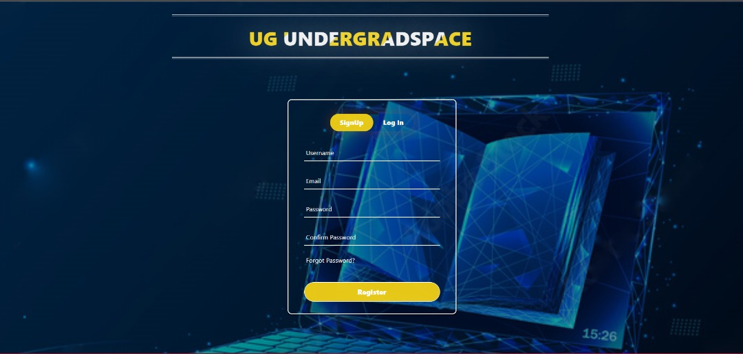

Slide 18
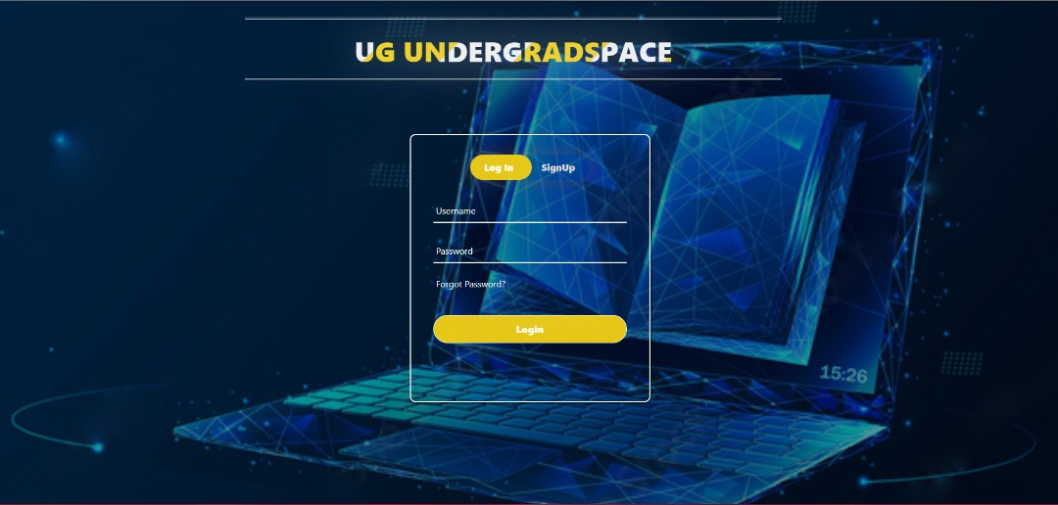

Slide 19
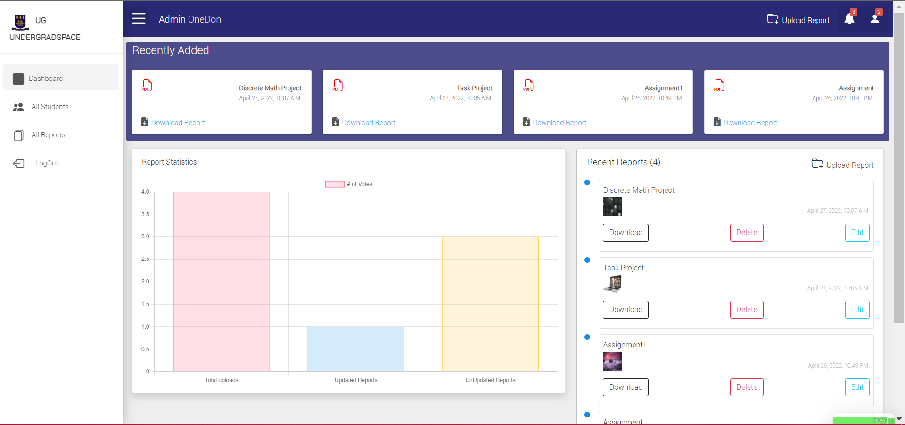

Slide 20
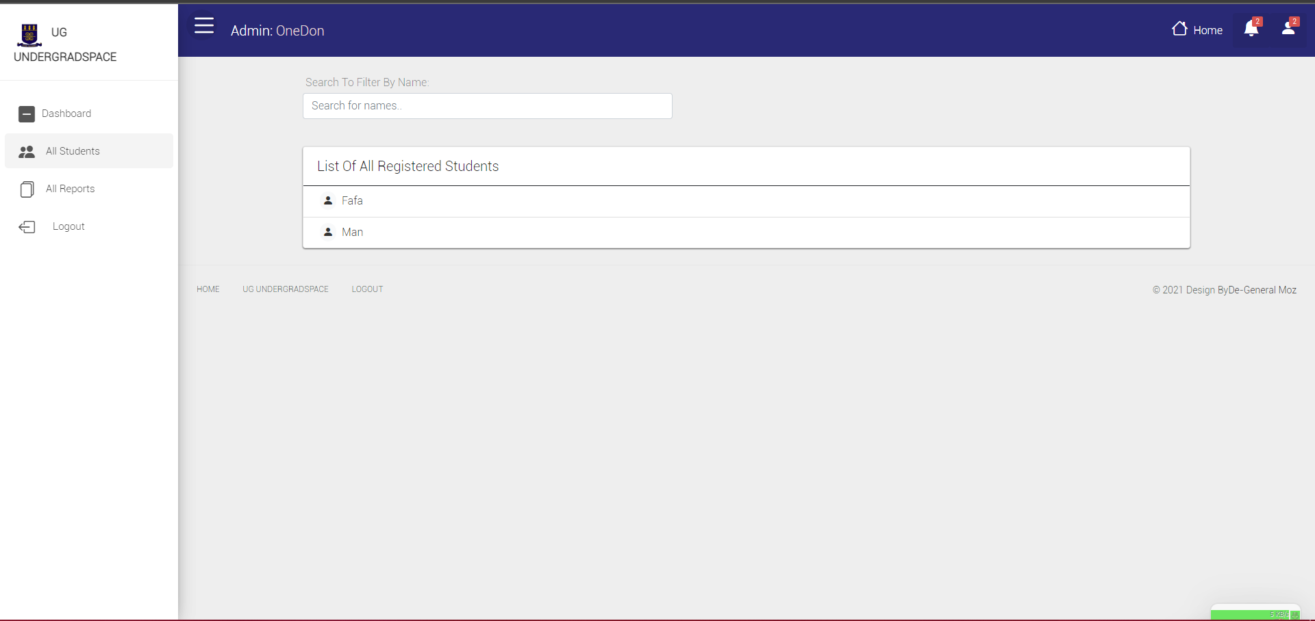

Slide 21
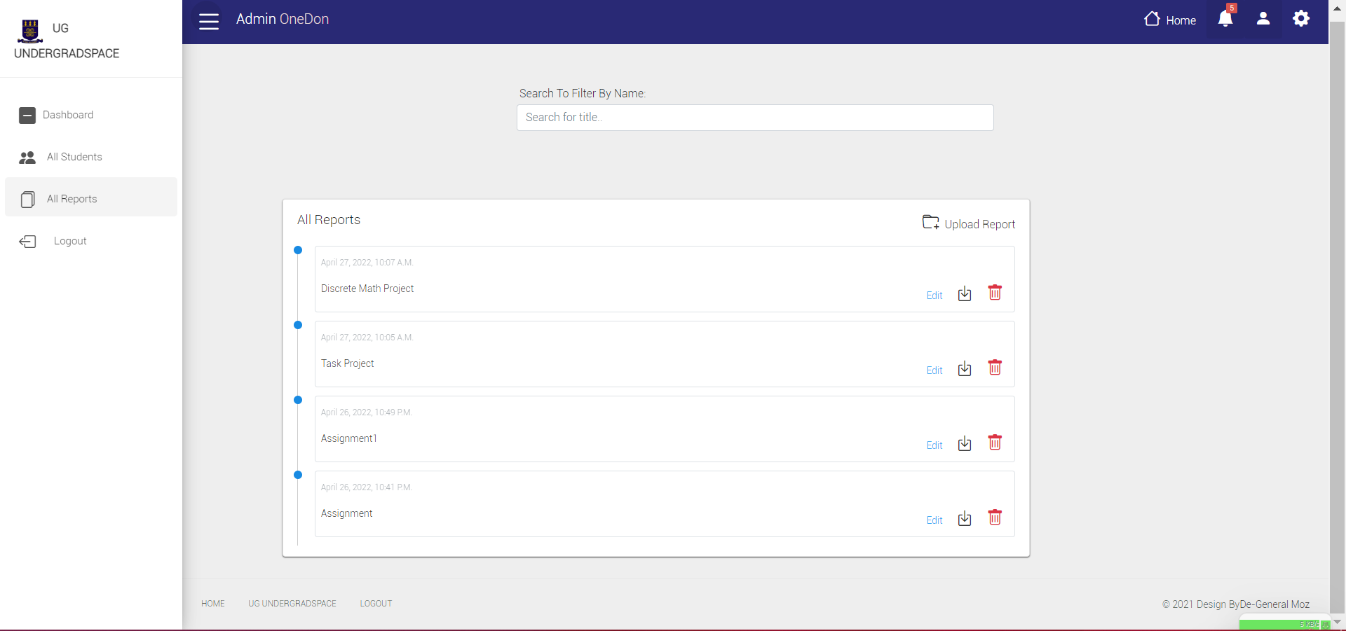

Slide 22
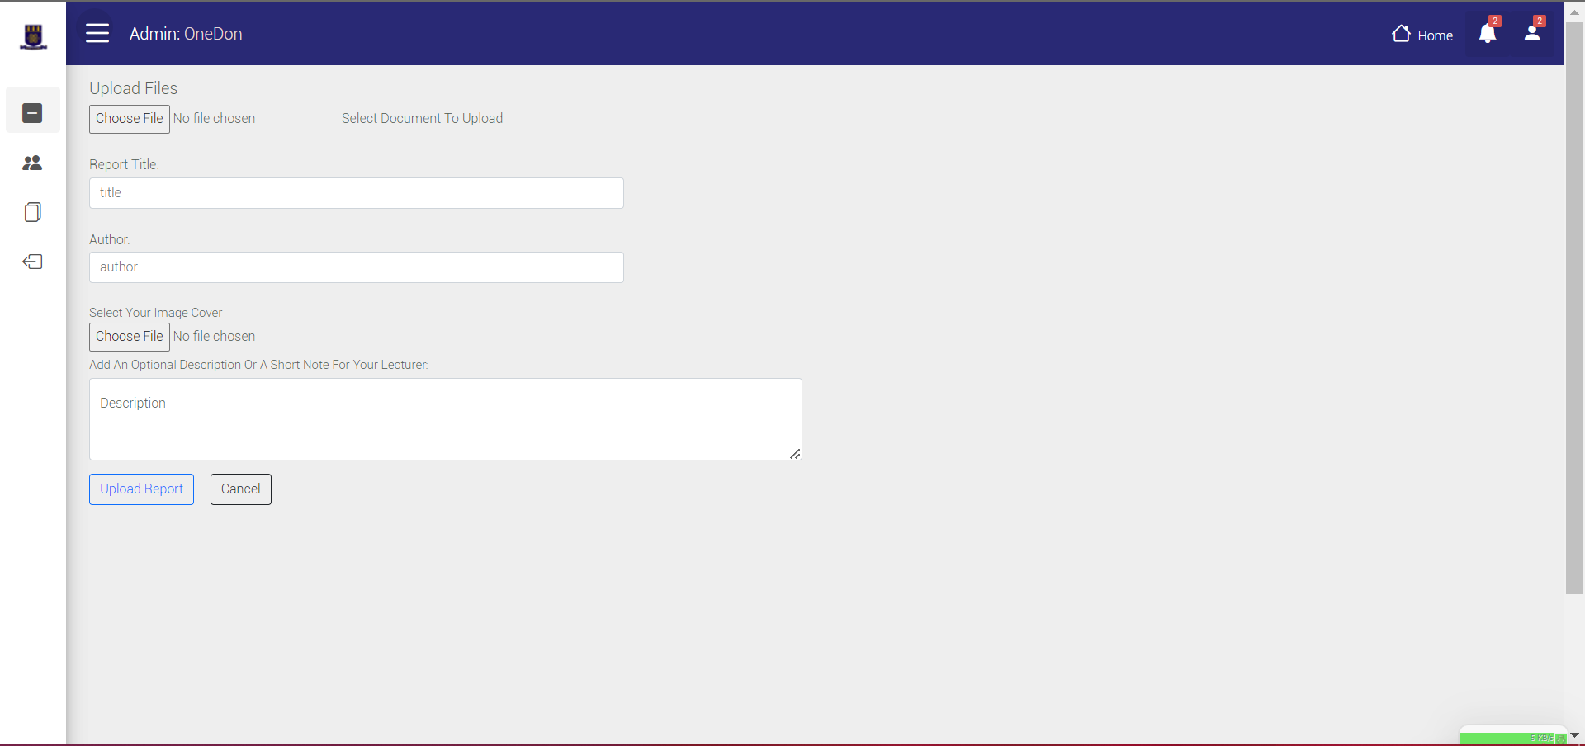

Slide 23
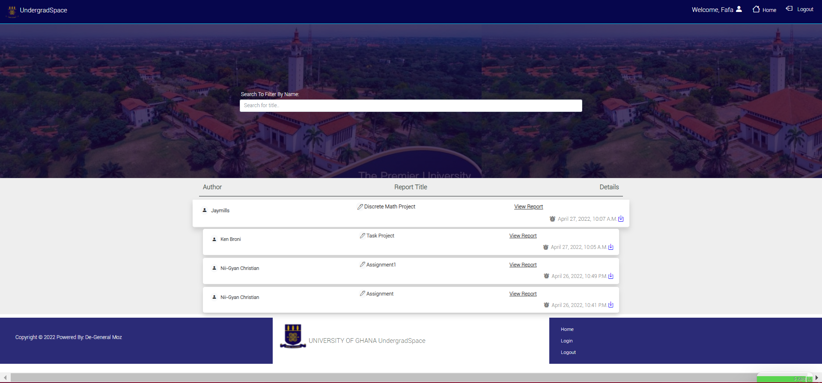

Slide 24
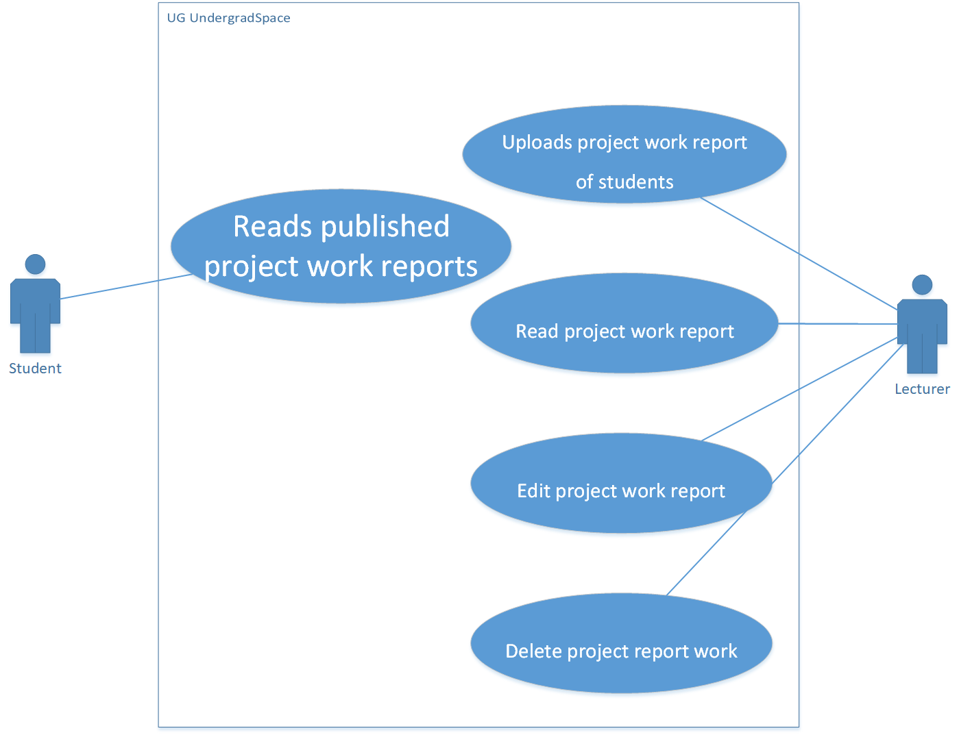

Slide 25
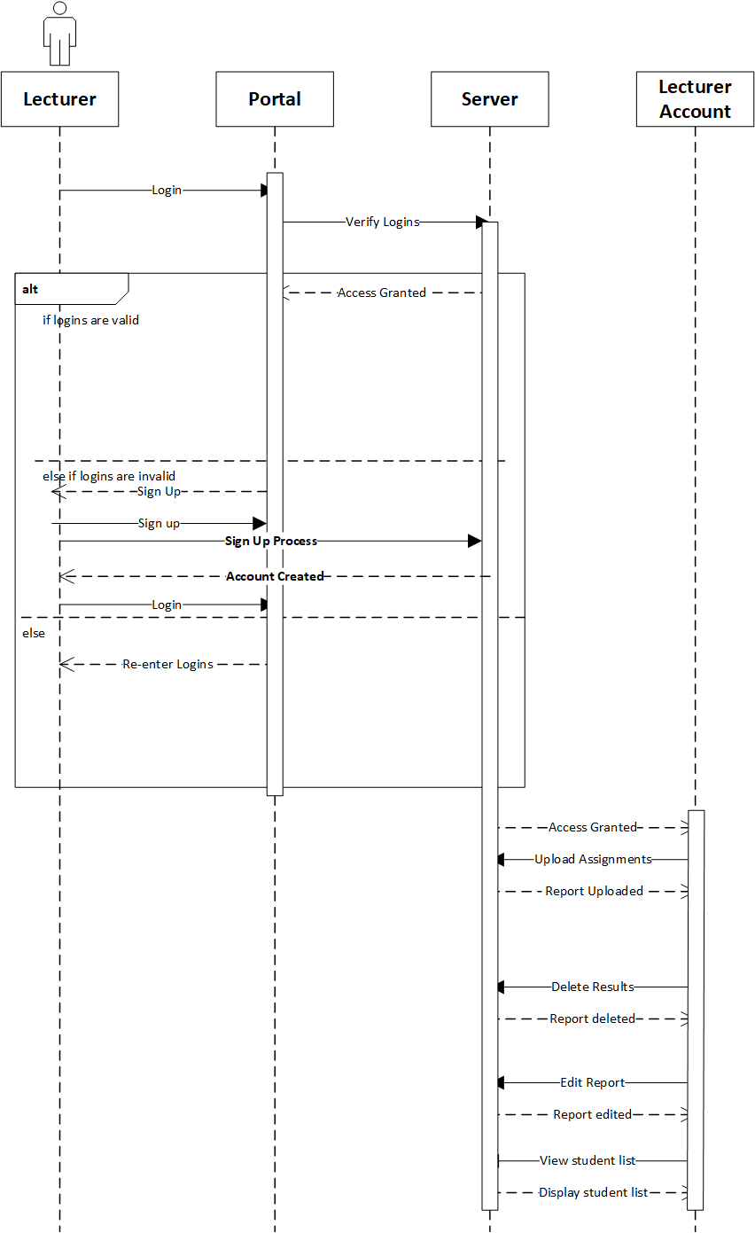

Slide 26
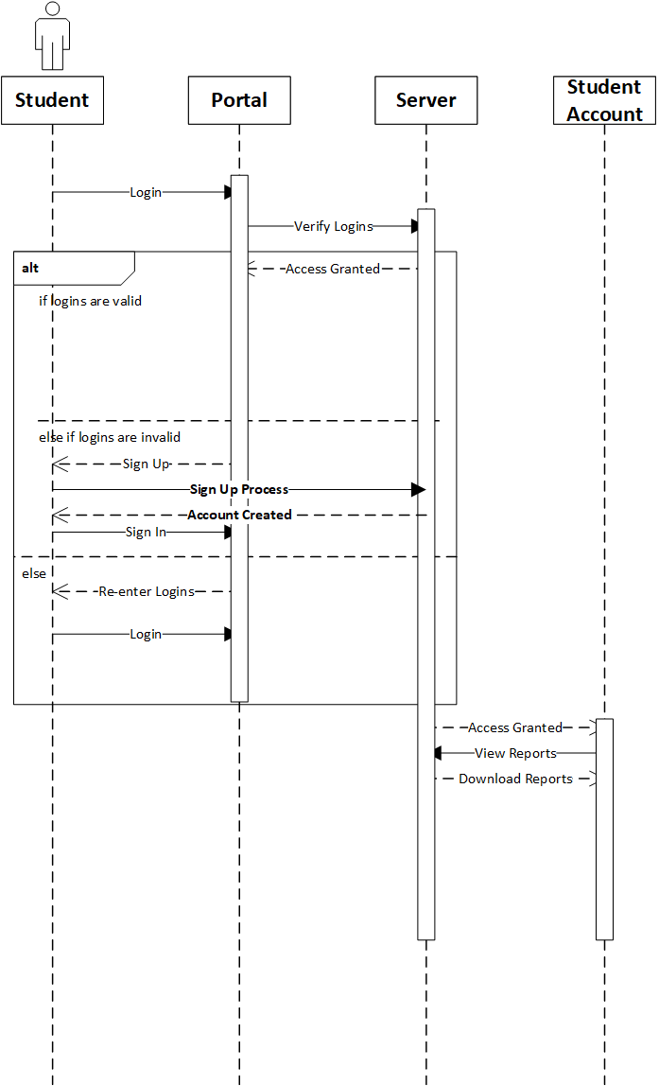

Slide 27
PROJECT COST
$10,000

Slide 28
ROLES OF INDIVIDUAL MEMEBERS
FRONT END:
FAFA ABOAGYE(LEADER), AKUA SERWAA NKRUMAH.
BACK END:
NII-GYAN CHRISTIAN(LEADER) , MAAME YAA HENEWAA.
UML DIAGRAMS AND SEQUENCE:
JAYMILLS PRINCE.
POWERPOINT PRESENTATION:
MAAME YAA HENEWAA,AKUA SERWAA.

Slide 29

THANK YOU!!

